Slide 1
POWER APPS

Slide 2
Agenda
Microsoft Power Platform
What is Power Apps?
Dataverse
Get Start With Power Apps
Types of Power Apps
Canvas Apps
Model-Driven Apps
Power App Portal

Slide 3
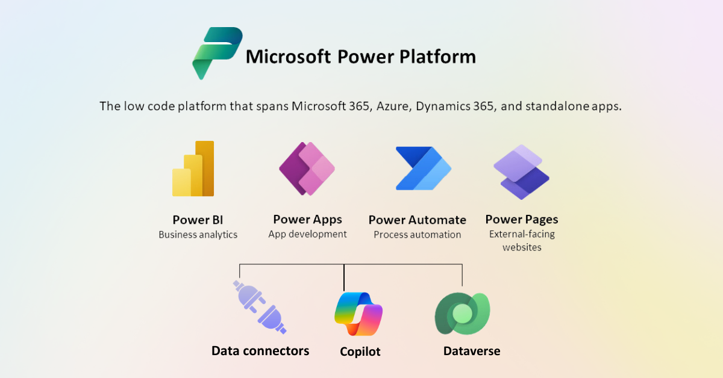
Microsoft Power Platform

Slide 4
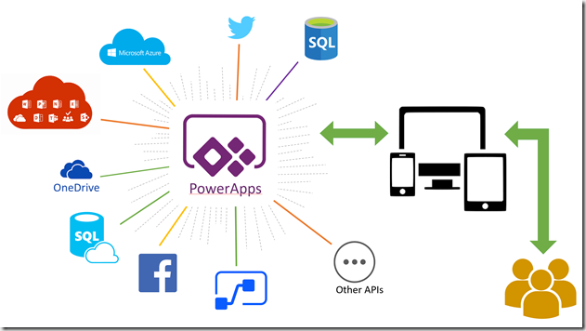
What is Power Apps?
Power Apps is a suite of apps, services, and connectors, as well as a data platform, that provides a rapid development environment to build custom apps for the business needs.
Using Power Apps, we can quickly build custom business apps that connect to our data stored either in the underlying data platform (Microsoft Dataverse) or in various online and on-premises data sources (such as SharePoint, Microsoft 365, Dynamics 365, SQL Server, and so on).

Slide 5
Power Apps for app makers/creators
To create an app, you start with make.powerapps.com .
Power Apps Studio is the app designer used for building canvas apps. The app designer makes creating apps feel more like building a slide deck in Microsoft PowerPoint.
App designer for model-driven apps lets you define the sitemap and add components to build a model-driven app.

Slide 6
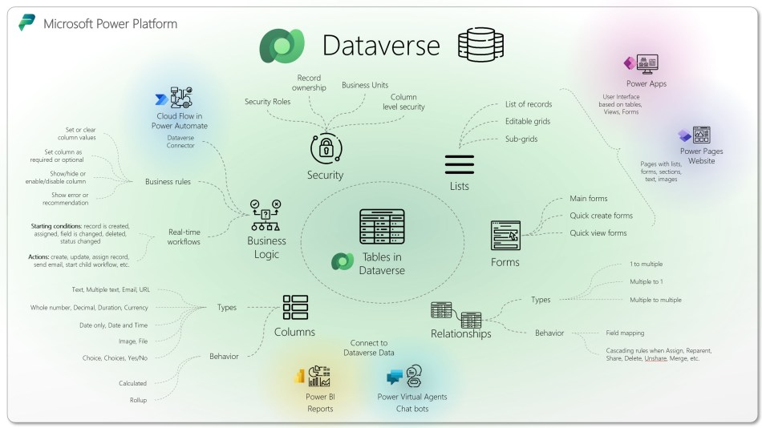
Dataverse
Dataverse is the data platform that comes with Power Apps and allows you to store and model business data.
Data within Dataverse is stored within a set of tables.

Slide 8
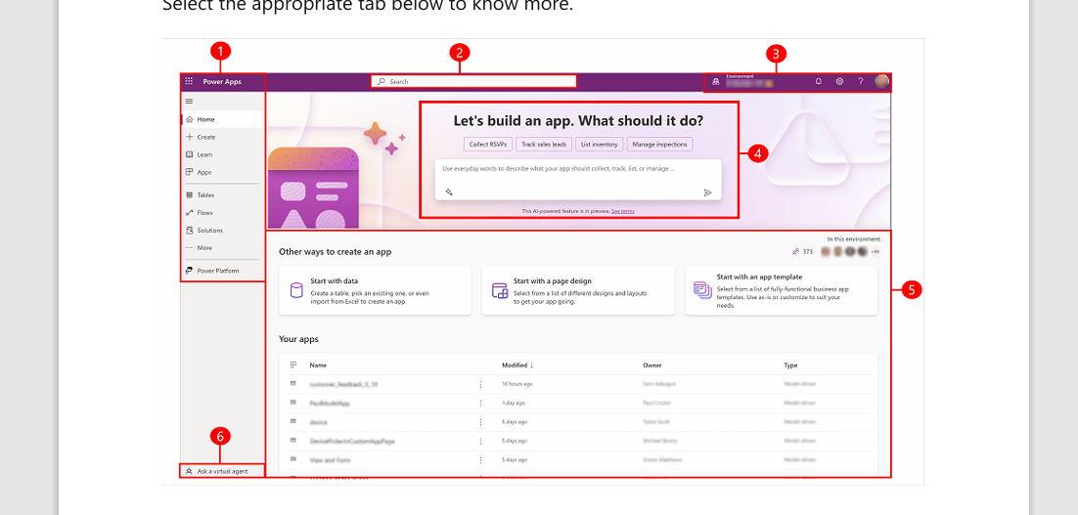
Get Started With Power Apps Development process
Legend:
1. Left navigation pane
2. Search
3. Environment information and settings
4. Copilot in Power Apps
5. Build apps
6. Get help from a virtual agent

Slide 9
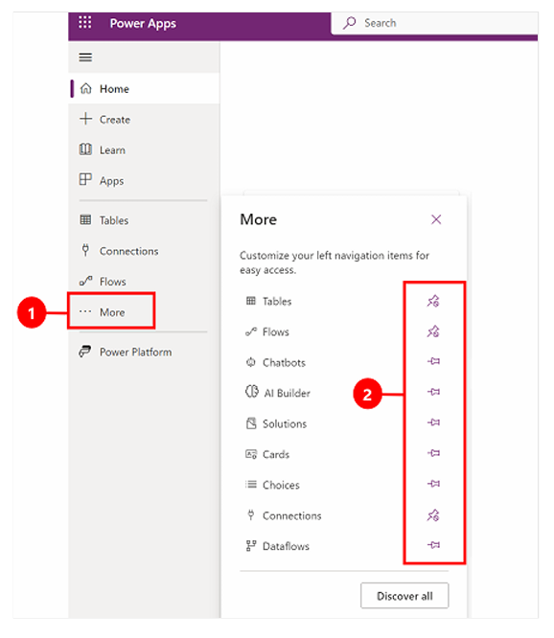
To pin or unpin a page from the left navigation pane, select More, and then select the pin or unpin button.

Slide 10
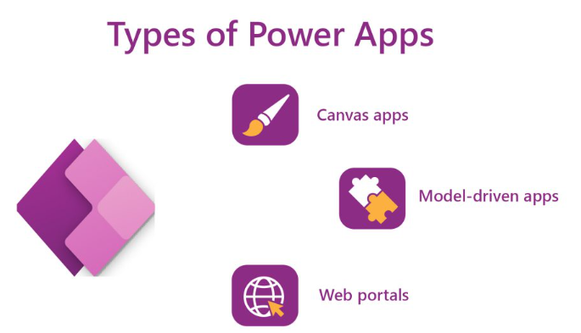
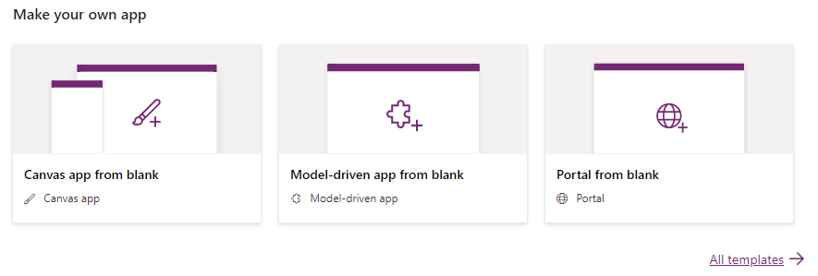
Power Apps Types
Canvas Apps
Model Driven Apps
Power Apps Portal

Slide 11
CANVAS APPS

Slide 12
Agenda
What is Canvas Apps?
Types of Variables in Canvas Apps
Naming Conversion in Canvas Apps
Components of Canvas Apps

Slide 13
Canvas apps
We can build canvas apps for web, mobile, and tablet applications.
Canvas apps are apps that start with a blank canvas, where the user can design the user interface (UI) by dragging and dropping elements such as buttons, text boxes, galleries, forms, and media.
Canvas apps can connect to various data sources and services using connectors, such as SharePoint, Excel, SQL Server, Twitter, and more.

Slide 14
Key characteristics of canvas apps
No coding required: Building apps doesn’t require writing code in programming languages like C#. Instead, you drag and drop pre-built controls like buttons, galleries, and text boxes onto a canvas, similar to designing a PowerPoint slide.
Data integration: Canvas apps seamlessly connect to various data sources within Dynamics 365, including Common Data Service (CDS), customer relationship management (CRM), and enterprise resource planning (ERP) data. This allows you to display, create, update, and delete data directly within the app.
Customisable: The platform offers a vast library of ready-made controls and templates, enabling you to create unique and user-friendly applications. You can customise the look and feel, functionality, and data connections to match your specific requirements.
Embedding: Canvas apps can be embedded directly within Dynamics 365 forms, dashboards, and portals, providing context-specific functionality alongside existing data and features. This streamlines workflows and eliminates the need to switch between different applications.
Accessibility: Power Apps offers native mobile functionality, allowing you to build apps accessible on smartphones and tablets, further enhancing mobility and flexibility for users.

Slide 15
Types of Variables
Three different types of variables which are available in PowerApps
Local variables
Global Variables
Collections
Variables types | Scope | Description | Functions related to variable
Global variable | App | This is similar to a global variable in programming language and it can hold a number, text string, Boolean, record, table, etc. as a data value | Set
Context variables | Screen | This is similar to the parameter which we pass to methods or procedure and this variable can be referenced from only one screen | UpdateContext Navigate
Collections | App | This variable can store table which can be referenced across anywhere in the app | Collect ClearCollect

Slide 16
Global Variable
Select Canvas app from blank as a type of PowerApps
Provide the name of the app as GlobalVariable and select the format as Tablet
Add a text input, label, and button from the insert table
Select the button and update the formula in OnSelect
Syntax: Set(global Variable,TextInput1.Text)
Now select the label field and update the formula in the Text field
global Variable

Slide 17

Local Variable
Click on create
1
Select Canvas app from blank as a type of PowerApps
2
Provide the name of the app as contextVariable and select the format as Tablet
3
Add a text input, label, and button from the insert table
4
Select the button and update the formula in OnSelect
5
1.Button Onselect -Update Context({contextVariable:TextInput1.Text})
2.Label – Pass the Local variable Value (ContextVariable)
Syntax: UpdateContext({Local Variable:TextInput1.Text})

Slide 18
Collections
Use a collection to store data that users can manage in your app. A collection is a group of items that are similar, such as products in a product list.
Collect, Clear, and ClearCollect functions
Collect: Add Records to Data Source
Clear: Delete Records.
ClearCollect: Add & Delete Records.

Slide 19
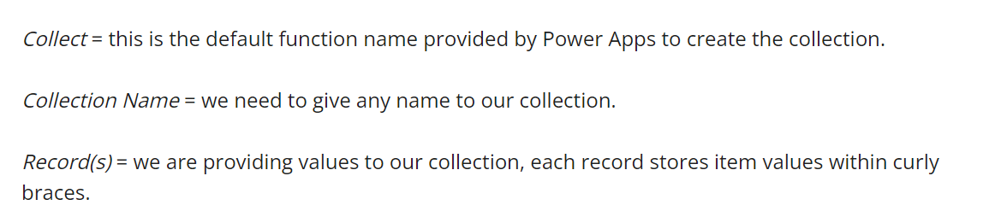
Syntax - Collect (Collection Name, record(s))
Example:
Collect (EmployeeDetails, {EmpID: "11021051", Designation: "Software Developer"}, {EmpID: "11021052", Designation: "Product Manager"}, {EmpID: "11021052", Designation: "HR"})

Slide 20
Naming Conversion
Screen Names
Control Names
Variable Names
Collection Names
Datasource Table Name
Naming Conversion

Slide 21
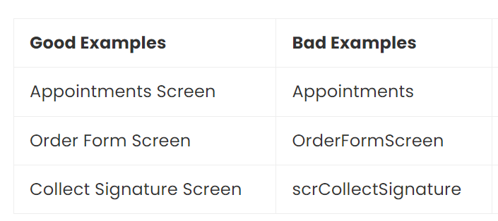
Screen Names
A screen name should clearly describe its purpose in 2-3 words ending with word “Screen.”
Use proper-case.
A screen-reader will speak the screen name to visually-impaired users when the screen loads.

Slide 22
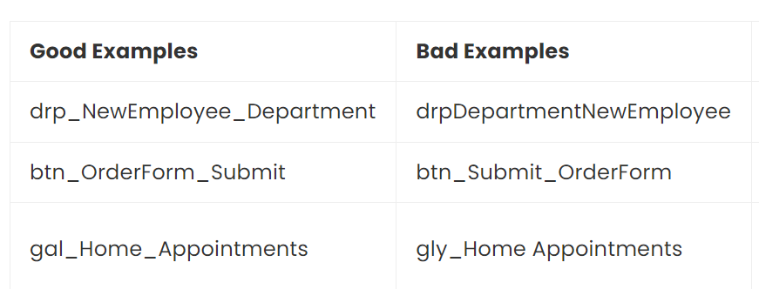
Control Names
A control name should show the control-type, the purpose and the screen.
Use camel-case and underscores for spacing.
For example, the control named txt_OrderForm_FirstName is a text input that captures first name on the app’s Order Form Screen.

Slide 23
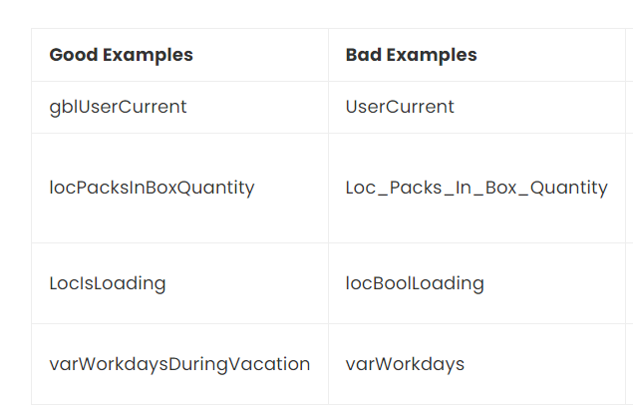
Variable Names
A variable name should show the scope of the variable and its purpose.
Use camel-case with no spaces between each word.
For example, the variable gblUserEmail is a global variable which holds the current user’s email address

Slide 24
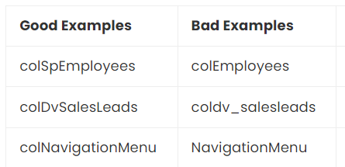
Collection Names
A collection name should contain the original datasource and describe its purpose.
Use camel-case with no spaces between each word.
For example, the collection colDvInvoices is a collection of invoices from Dataverse.

Slide 25
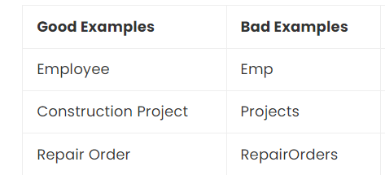
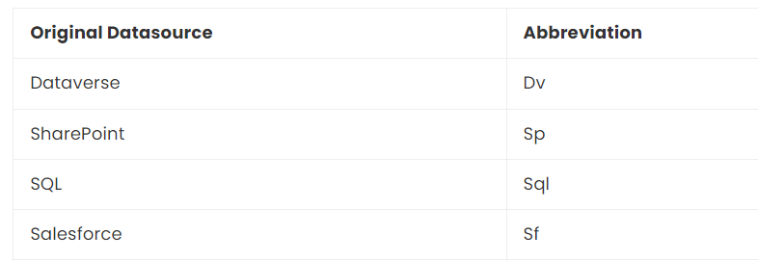
Datasource Table Names
A datasource created by the developer should have 1-3 words to describe its purpose.
Use the singluar form of the word and proper-case.
Be as concise and clear about the purpose of the datasource as possible.

Slide 26
COMPONENTS

Slide 27
Components of Canvas Power apps
Gallery
Screen
Card
Control
Property
Functions

Slide 28
Gallery
Power Apps Gallery is a type of control that can display a set of records from a data source.
In the gallery, each record holds multiple types of data.
Also, it can contain other input controls.

Slide 29
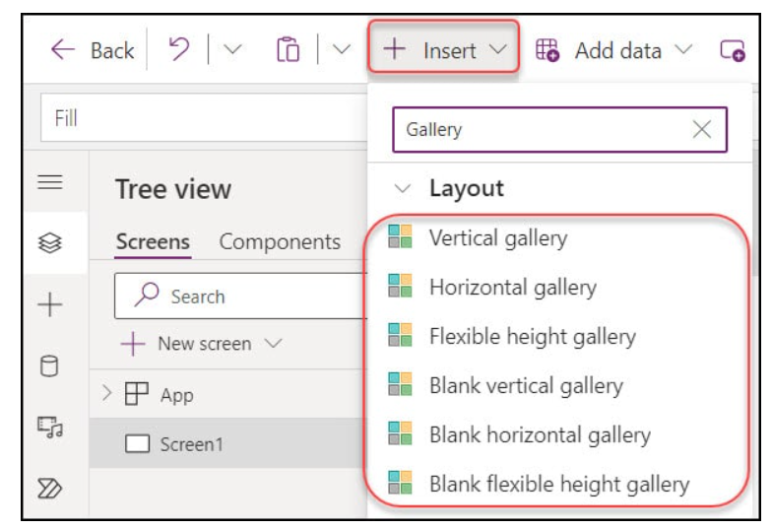
Power Apps Gallery Types
Vertical gallery
Horizontal gallery
Flexible height gallery
Blank vertical gallery
Blank horizontal gallery
Blank flexible height gallery

Slide 30
Gallery Limitations
Limitation Category | Description
Item Display | Gallery control displays items in a single column (for vertical galleries) or a single row (for horizontal galleries), so layouts with multiple columns/rows need workarounds.
Data Source | While the gallery can connect to many data sources, performance may vary, especially with large data sets. Fetching and rendering thousands of items can be slow.
Item Limit | There’s a limit to the number of items a gallery can display, driven by the “Data row limit” for non-delegable queries (500, by default, can be increased to 2,000).

Slide 31
Not Supported Controls | Within a gallery, the following controls are not supported: – Display form – Edit form – PDF viewer – Power BI tile – Rich text editor – Scrollable screen (Fluid grid)
One Gallery can be added | Only one gallery can be added inside of another gallery.
TemplateSize | TemplateSize must be at least one. If you don’t consider the template size, controls in the Gallery may deviate from their intended X or Y values.

Slide 32
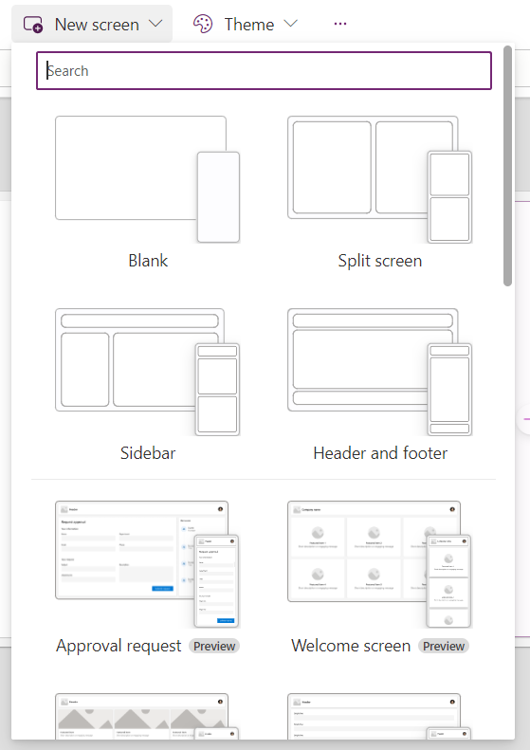
Screen
When you click on new screen, you can see variety of screens in the drop down.Based on the requirement, we can select our screen.
Screens are the different pages or views within a PowerApp.
Users can navigate between screens, and each screen can contain different controls and layouts.
Screens serve as the foundation for creating the user interface of the app

Slide 33
Screen
Home Screen:
The landing page of the app where users start and navigate to other screens.
Detail Screen:
Shows detailed information about a selected item from a gallery or list.
Form Screen:
Contains forms for data entry or editing records.
Search and Results Screens:
Displays search results and allows users to interact with them.
Settings or Profile Screens:
Provides user-specific settings or profile information

Slide 34
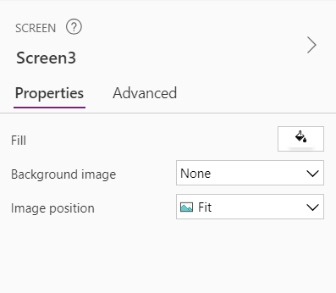
Colour contrast
The Screen is the effective background for text, there must be adequate color contrast between:
Fill and text
Background image and text (if applicable)
There must be a meaningful name for each Screen.

Slide 35
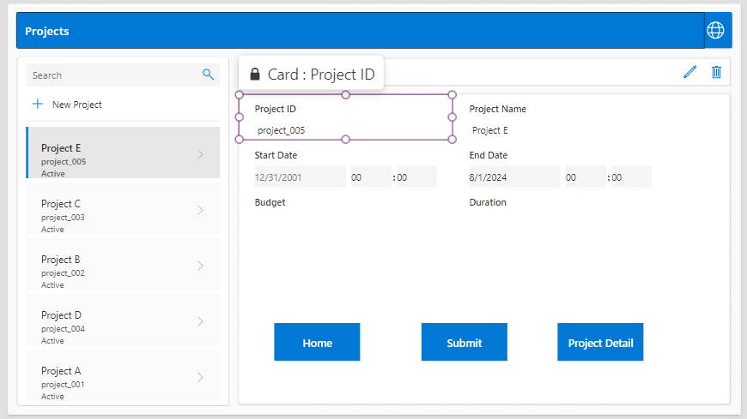
Cards
Cards are containers within forms that display individual fields from data sources.
They can be customized to show various types of input controls like text boxes, drop-down lists, or date pickers.
Cards help in organizing and displaying data entry fields in a form.

Slide 36
Components of a Card:
Data Card: The primary container for the form field. It includes the label (to describe the field), the input control (like a text box, dropdown, or date picker), and any validation messages.
Control: This is the input or display control within the card, such as a text input, dropdown list, or date picker.
Label: Displays the name of the field or any instructional text.

Slide 37
Types of Cards:
Edit Form Card: Used to allow users to edit or input data. Controls inside these cards are usually bound to the data source fields.
Display Form Card: Used to display data from a data source. These cards are usually set to read-only mode.
Using Cards in Forms:
Creating Forms: Cards are automatically generated when you add fields to a form. You can use the Form control to bind to a data source and automatically generate cards.
Custom Forms: You can manually add cards to forms if you need more control or customization than the automatic generation provides.

Slide 38
Purpose of Cards:
Display Data: Cards show data from a data source in a form.
Collect Input: They allow users to input or edit data which is then saved back to the data source.
Card Properties:
DataField: Specifies the data field from the data source that the card represents.
Update: The formula that specifies how the card’s data should be updated in the data source.
Default: The default value for the card when the form is loaded.

Slide 39
Customization:
Design: You can customize the layout and design of the card to better fit your app's needs. This includes resizing, rearranging, or adding additional controls.
Visibility: Cards can be made visible or hidden based on conditions, which helps in creating dynamic forms.
Validation: Cards can include validation rules to ensure data integrity before submitting.
Common Controls in Cards:
Text Input: For entering or displaying text.
Dropdown: For selecting from a list of options.
Date Picker: For selecting dates.
Checkbox: For binary choices (yes/no).

Slide 40
Controls
Controls are the building blocks of Power Apps.
They are used to display data, accept user input, and perform actions.
Common controls include buttons, text input boxes, labels, combo boxes, and sliders.
Controls can be configured to behave dynamically based on user interactions or data changes

Slide 41
Canvas App – Controls Categories
Input
Display
Layout
Media
Icons
Shapes
Charts

Slide 42
Text Controls:
Label: Displays text on the screen. It’s often used for headings, descriptions, or static text.
Text Input: Allows users to enter and edit text. It can be used for single-line or multi-line input.
Rich Text Editor: Allows users to input and format text with different styles (bold, italic, etc.).
Numeric and Date Controls:
Number Input: For entering numerical values. It includes options for formatting and specifying minimum/maximum values.
Date Picker: Provides a calendar interface for selecting dates. Useful for inputting date values.

Slide 43
Layout Controls:
Container: Provides a flexible layout for positioning and aligning other controls. It can be used to create responsive designs.
Flexible Height/Width: Allows controls to adjust their size based on content or screen size, useful for responsive design.
Media Controls:
Image: Displays images from a file or URL. It supports various image formats.
Camera: Captures images using the device’s camera.
Audio: Plays audio files and allows recording of audio from the device’s microphone.
Video: Plays video files or streams video content.

Slide 44
Data Controls:
Gallery: Displays a collection of items in a list or grid layout. Useful for showing multiple records or images.
Data Table: Displays data in a tabular format, with built-in features for sorting and filtering.
Form: Used to create and edit records. It can be in "Edit" or "Display" mode, allowing data entry or view-only access.
Interactive Controls:
Button: Triggers an action or event when clicked. Often used to submit forms, navigate between screens, or perform other tasks.
Toggle: Provides a binary choice similar to a checkbox but with a more visual on/off switch.
Slider: Allows users to select a value from a range by sliding a handle.

Slide 45
Container Controls:
Group: Organizes multiple controls into a single container. Useful for managing layout and positioning.
Tab: Allows for navigation between different sections or views within the same screen.
Screen: Represents a separate view or page within the app. Controls are added to screens to create the app’s user interface.
Advanced Controls:
HTML Text: Renders HTML content, allowing for rich text formatting and inclusion of HTML elements.
Pen Input: Captures freehand drawings or annotations from the user.
Barcode Scanner: Scans barcodes or QR codes using the device’s camera and retrieves the scanned data.

Slide 46
Choice Controls:
Dropdown: Allows users to select one option from a list of choices. It’s compact and ideal for forms with limited space.
Combo Box: Similar to Dropdown but allows for search and multi-select options.
Radio: Displays a set of options where only one can be selected at a time. Useful for mutually exclusive choices.
Checkbox: Provides a binary choice (checked or unchecked). Often used for options that can be turned on or off.

Slide 47
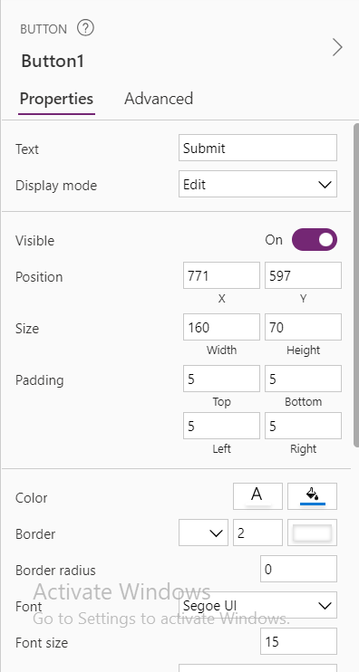
Properties
Properties define the characteristics and behavior of controls.
They include attributes like size, color, text, and visibility.
By setting properties, users can customize the appearance and functionality of controls.
Properties can also be linked to formulas to make them dynamic

Slide 48
Common Properties:
Text
Value
Items
Default
OnSelect
Visible
DisplayMode
Width
Height
X
Y
Color
Fill

Slide 49
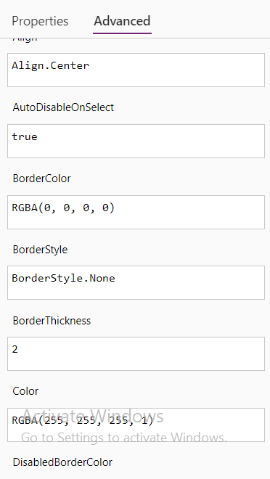
Advanced Properties:
BorderColor
BorderThickness
HoverColor
PressedColor
Padding
Margin
Tooltip

Slide 50
Specialized Properties for Data-Related Controls:
DataField
Update
DefaultSelectedItems
Event-Related Properties:
OnVisible
OnChange
OnSuccess
OnFailure

Slide 51
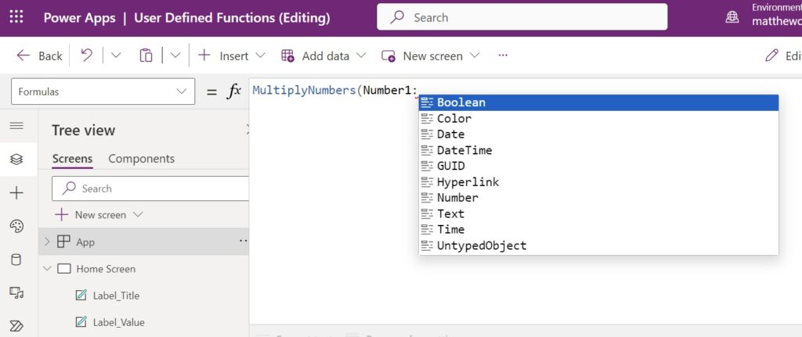
Functions:
Functions are used to perform operations on data, control behavior, and manipulate the user interface.
PowerApps provides a wide range of built-in functions, such as mathematical operations, text manipulation, and data filtering.
Apps can be used to create formulas for different properties, such as OnSelect, Default, and Items.

Slide 52
Date and Time Functions:
Now
Today
Date
DateDiff
Weekday
Mathematical Functions:
Abs
Round
Sqrt
Power
Text Functions:
Len
Mid
Left
Right
Concatenate
Upper
Lower
Trim

Slide 53
Data Functions:
LookUp
Filter
Sort
Distinct
First
Last
CountRows
Sum
Logical Functions:
If
And
Or
Not
Collection Functions:
Collect
Clear
ClearCollect

Slide 54
Control Functions:
Navigate
Reset
SubmitForm
Error Handling Functions:
IsError
IfError
Text Formatting Functions:
Text
FormatDateTime
Others:
Notify
User

Slide 55
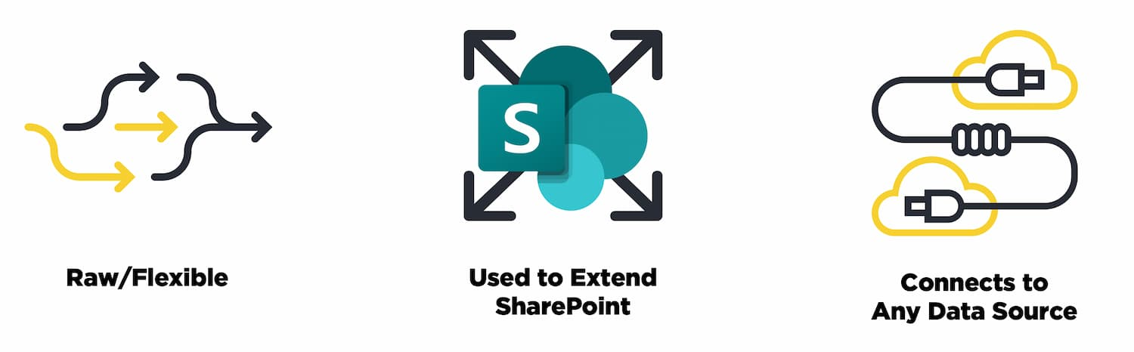
It’s Raw and Flexible
It have a lot of control over the interactions that users have with data and with elements within the app
It’s a Foundation for Extending SharePoint
It opens up a specialized version of a canvas app within Power Apps
It Can Connect to A Lot of Data Sources

Slide 56
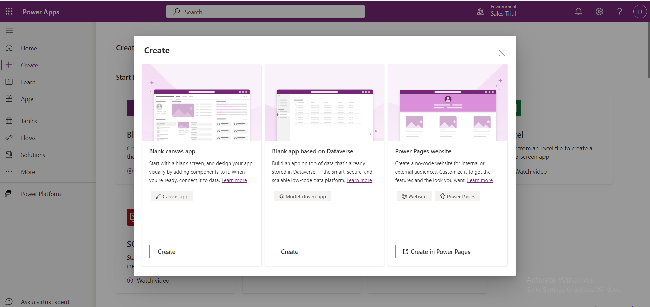
How to create canvas App:

Slide 57
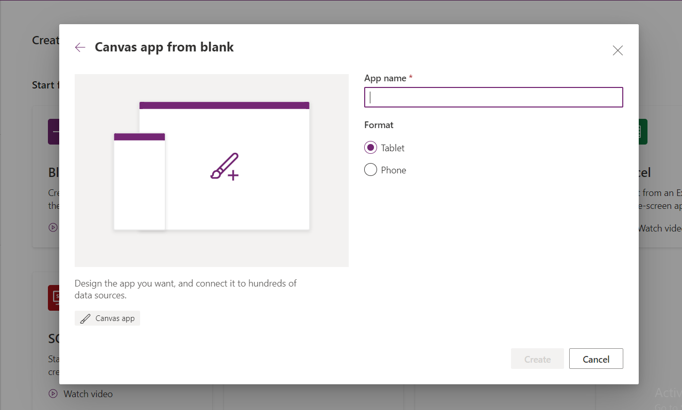
Give the app name here and select anyone format and click create

Slide 58
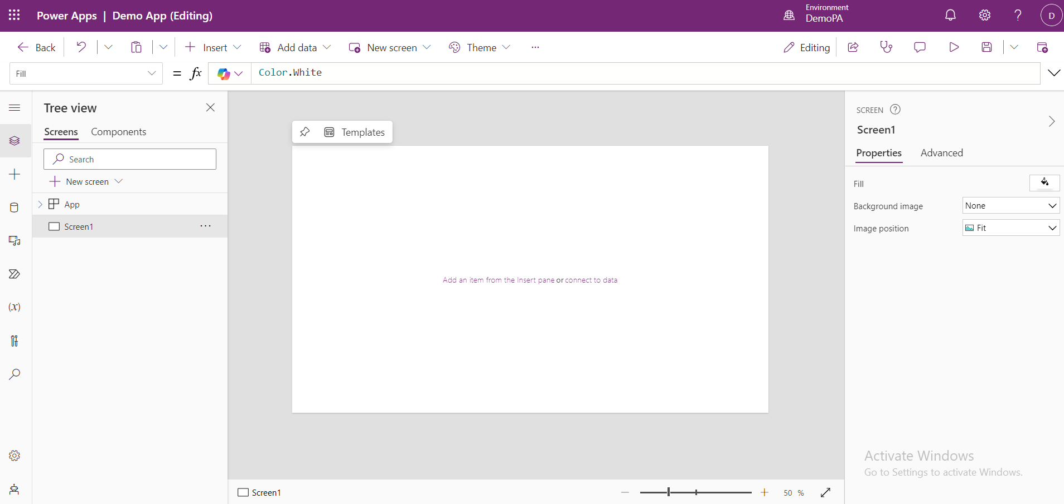
This is the Canvas Editing Page.

Slide 59
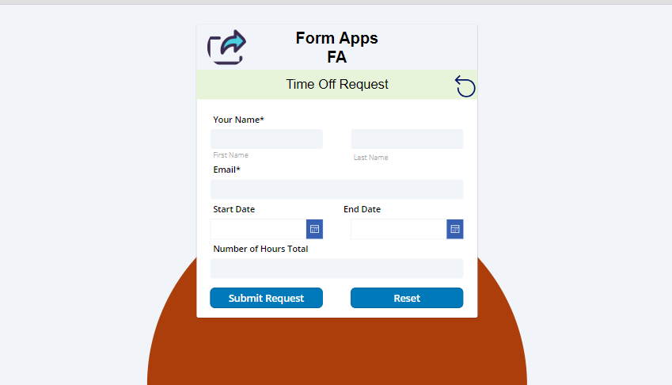
Example

Slide 60
Model-Driven Apps

Slide 61
Agenda
What is Model-Driven Apps?
Components of Model-Driven Apps
Types of Forms
Solutions
Site-map
Examples for Model-Driven Apps

Slide 62
Model-driven apps
Model-driven apps start with your data model – building up from the shape of your core business data and processes in the Dataverse to model forms, views, and other components.
Model driven apps allow the user to focus on the data and the business logic, rather than the UI design.
Getting started with model-driven apps is simple.
Create an app
Create and design forms
Create or edit views
Create or edit a system chart
Create or edit dashboards
Add security
Add business logic

Slide 63
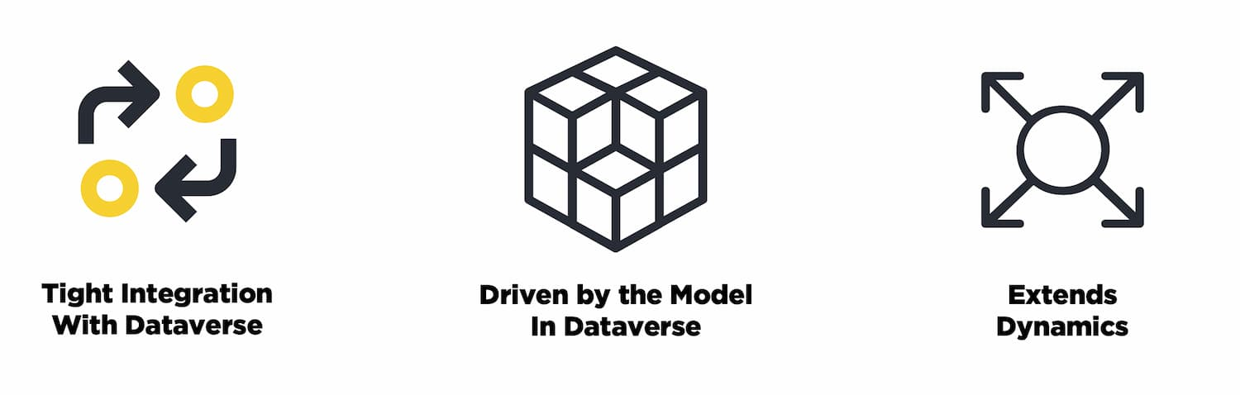
Model-driven apps are a paradigm built squarely on the Dataverse
Defined in Dataverse, Surfaced Through The App
defining the tables and entities within Dataverse with the appropriate forms, dashboards, charts and then surfacing them through a model-driven app
Extends Dynamics
This type of development is also the primary way that Dynamics is extended.

Slide 64
Components of Model-Driven Apps :
Forms
Views
Dashboards
Charts
Tables(Entities)
Business Process Flow
Field Types

Slide 65
Forms
Purpose:
Forms are used to create, view, and edit records in entities (tables).
Types:
Main Form: Used for detailed record creation and editing.
Quick Create Form: Simplified form for quick record creation.
Quick View Form: Displays related record information in a read-only format.
Card Form: Used in business process flows to show summary views.

Slide 66
Types of Forms
In Model-Driven Apps in Power Apps, forms are used within the context of entities (tables) to create, view, and edit records.
The primary form types in Model-Driven Apps are:
Main Form
Quick Create Form
Quick View Form
Card Form

Slide 67
Main Form
Purpose:
The primary form used to create and edit records for an entity.
Features:
Controls: Includes fields, sections, and tabs to display and gather information.
Data Binding: Directly bound to an entity and its fields.
Customization: Allows for extensive customization including field layouts, business rules, and embedded sub-grids or related records.

Slide 68
Types:
Create Form: Used when creating new records.
Edit Form: Used when editing existing records.
Properties:
Form Type: Determines whether the form is used for creating or editing records.
Form Order: Determines the sequence of forms when multiple forms are available.

Slide 69
Quick Create Form
Purpose:
A simplified form used to quickly create new records, often accessible from different areas within the application.
Features:
Controls: Typically contains only the most essential fields for quick data entry.
Data Binding: Same as Main Form but streamlined for faster data entry.

Slide 70
Properties:
Form Type: Set specifically for quick creation scenarios.
Visibility: Can be accessed from the navigation pane or embedded within other forms.

Slide 71
Quick View Form
Purpose:
Used to display read-only information from related records within another form.
Controls:
Displays data from a related entity in a read-only format.
Data Binding:
Retrieves data from related records and presents it within a section of another form.

Slide 72
Properties:
Form Type: Read-only and typically used within Main Forms or other Quick View Forms.
Configuration: Set up to show specific fields from related entities.

Slide 73
Card Form
Purpose:
Used within a business process flow to display a summary view of record data.
Features:
Controls:
Provides a summarized view of key information in a compact format.
Data Binding:
Displays information from the record associated with the business process.
Properties:
Form Type: Utilized within business process flows for streamlined data presentation.

Slide 74
Views
Purpose:
Views display lists of records from an entity in a grid format.
Types:
System Views: Default views provided by the system.
Personal Views: Custom views created by users to filter and sort data.
Public Views: Views shared across the organization.

Slide 75
Dashboards
Purpose: Dashboards provide a consolidated view of data and metrics.
Types:
System Dashboards: Pre-defined dashboards provided by the system.
Personal Dashboards: Custom dashboards created by users.
Interactive Dashboards: Allow users to interact with data visualizations

Slide 76
Charts
Purpose:
Visual representations of data, such as bar charts, pie charts, and line charts.
Types:
System Charts: Default charts provided by the system.
Custom Charts: User-defined charts to visualize specific data sets.

Slide 77
Tables (Entities)
Purpose:
Store and manage data in a structured format.
Features:
Fields: Define the data structure with various field types.
Relationships: Define relationships between different tables (one-to-many, many-to-many).
Views: Configure how data is displayed for each table.

Slide 78
Business Process Flows
Purpose:
Guide users through a series of steps or stages in a business process.
Features:
Stages and Steps: Define the stages and steps users follow.
Branching Logic: Implement conditional paths based on user inputs or data.

Slide 79
Field Types
Purpose:
Define the types of data that can be stored in fields within tables.
Types:
Text: Single line, multiline.
Number: Whole number, decimal.
Date/Time: Date, date and time.
Lookup: References to other records.
Option Set: Predefined choices.

Slide 80
Solutions
In Power Apps, Solutions are a critical feature for managing, distributing, and deploying customizations and components across different environments.
Solutions encapsulate various elements like apps, tables (entities), flows, and other components, allowing you to package and move them between environments effectively.

Slide 81
Creating and Managing Solutions:
Creating a Solution:
Go to the Power Apps Maker portal.
Navigate to the Solutions section.
Click New Solution and provide a name, publisher, and version.
Adding Components:
Open the solution you want to work with.
Click Add Existing to include apps, tables, or other components.
Use Add New to create new components within the solution.
Exporting a Solution:
Select the solution you want to export.
Click Export and choose between managed or unmanaged export.
Follow the prompts to download the solution package as a .zip file.

Slide 82
Creating and Managing Solutions:
Importing a Solution:
Go to the Power Apps Maker portal and navigate to Solutions.
Click Import and upload the .zip file of the solution.
Follow the prompts to complete the import process, including resolving any dependencies or conflicts.
Publishing and Uninstalling:
After importing a solution, you may need to publish the customizations to make them active.
To uninstall a solution, select it and click Uninstall. For managed solutions, this will remove all components unless otherwise customized.
Exporting a Solution

Slide 83
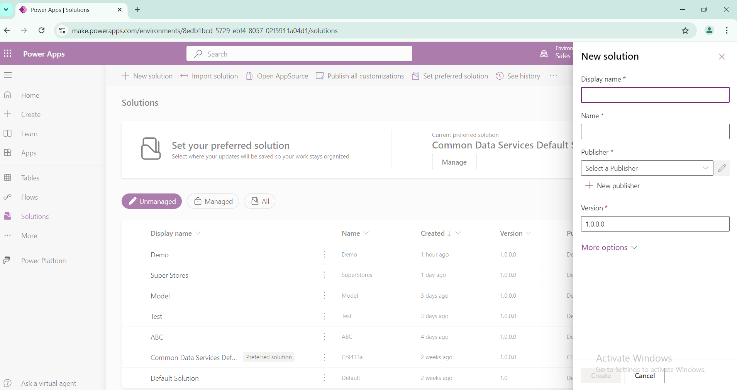
This is how the solution page looks and by providing Name, Publisher , it will create a solution name and take it to the solution publisher page.

Slide 84
Site Maps
The site map is a key component that defines the navigation structure and layout of the app.
It determines how users access different parts of the application, such as entities, dashboards, and custom.
Features:
Areas: Main sections of the app.
Subareas: Links to entities, dashboards, or web resources.
Navigation: Customize the navigation layout and items.

Slide 85
Site Map Editor
A tool in the Power Apps designer for creating and managing the site map.
Drag-and-Drop Interface:
Allows you to easily add, remove, or rearrange areas, subareas, and links.
Preview:
Provides a preview of how the site map will look to users.

Slide 86
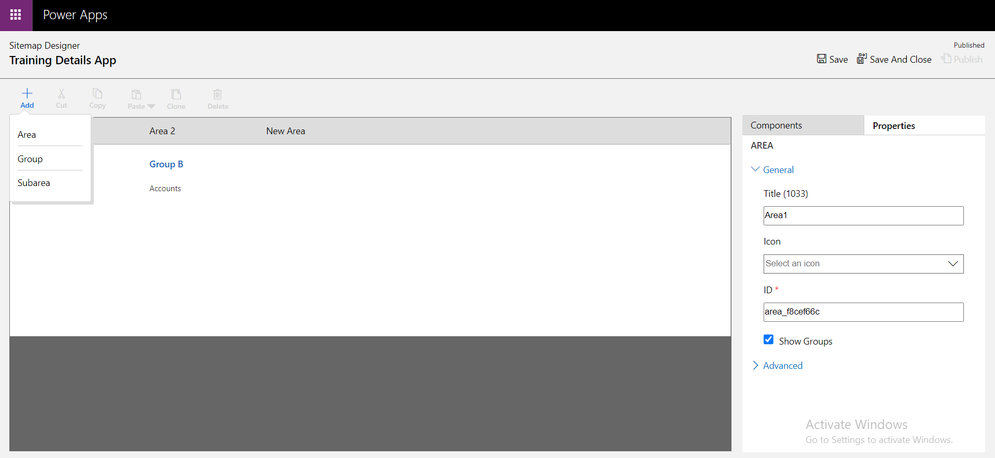
Sitemap designer Page Look.

Slide 87
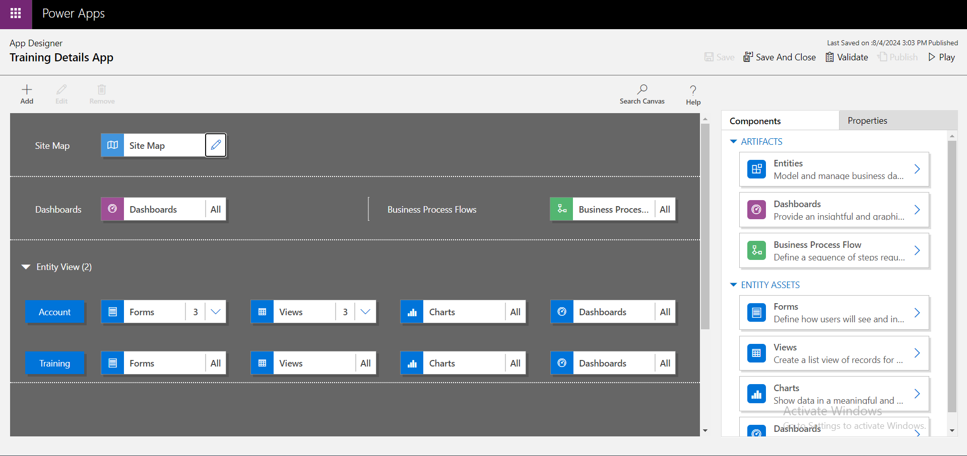
App designer Page Look.

Slide 88
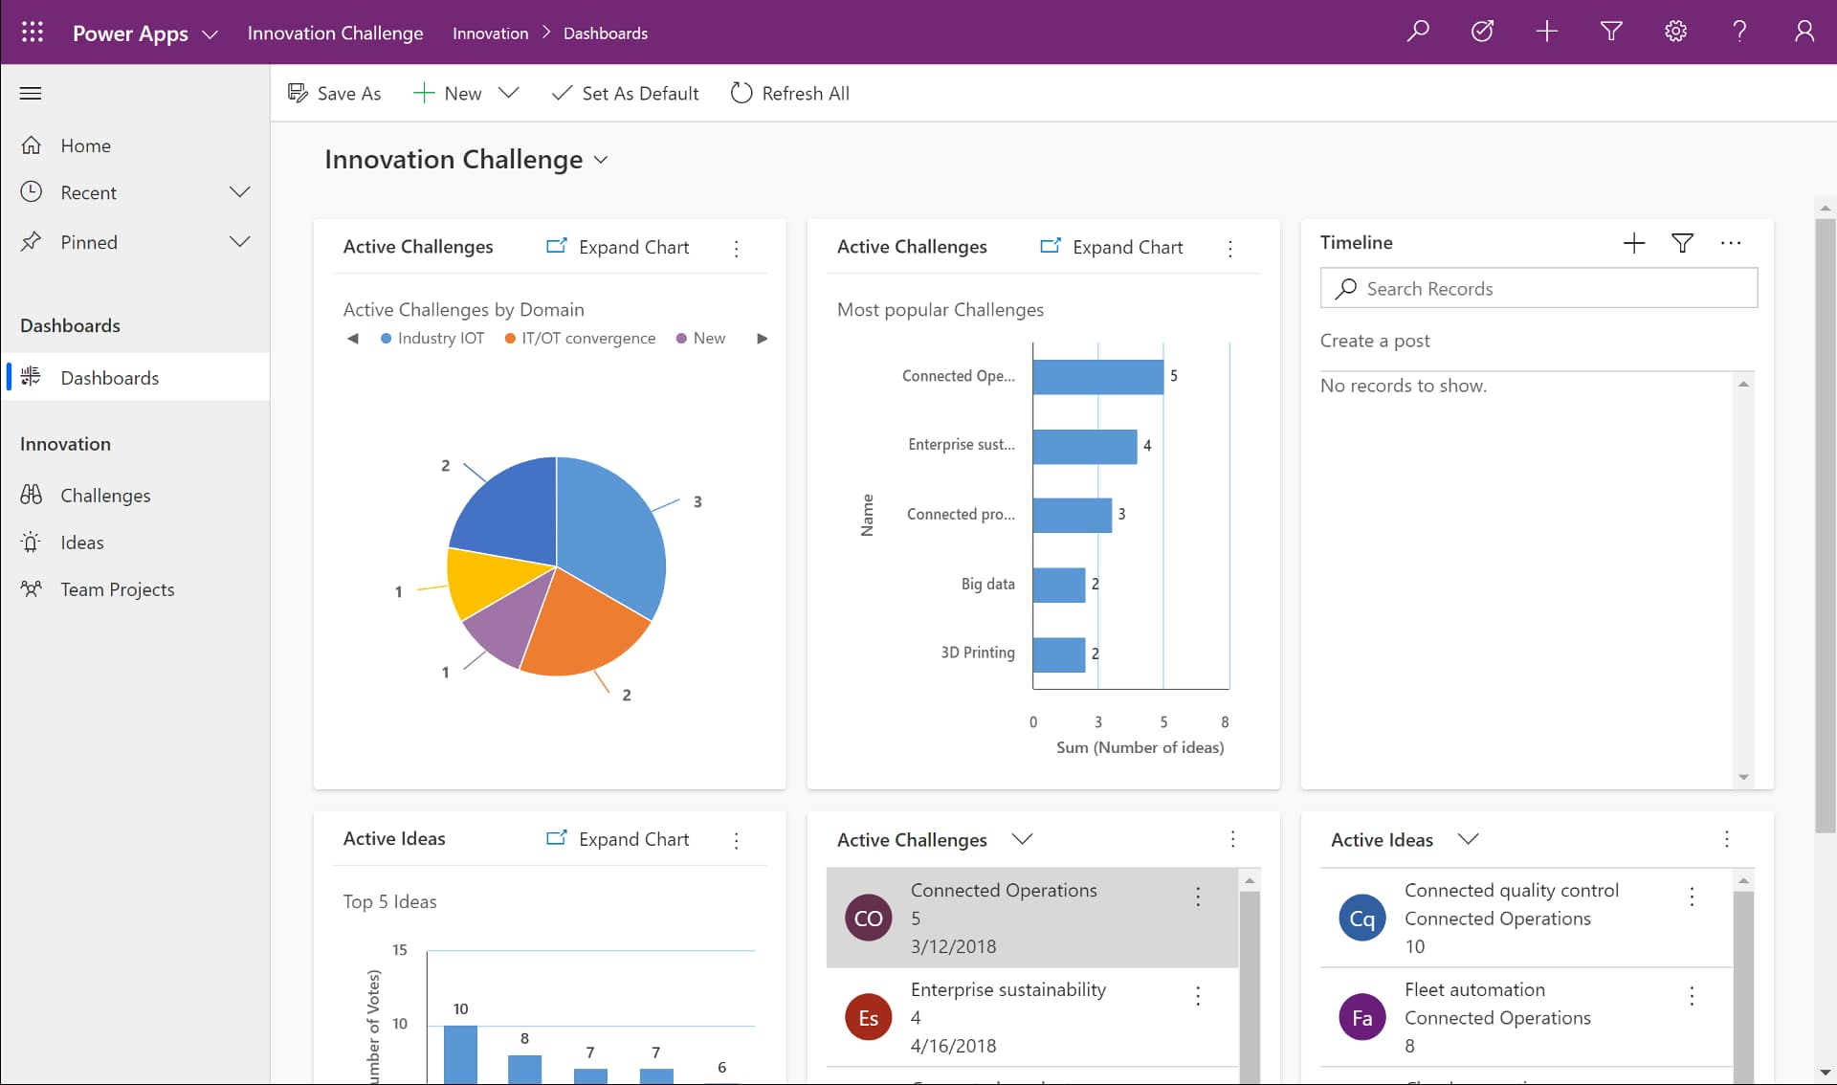
Example

Slide 89
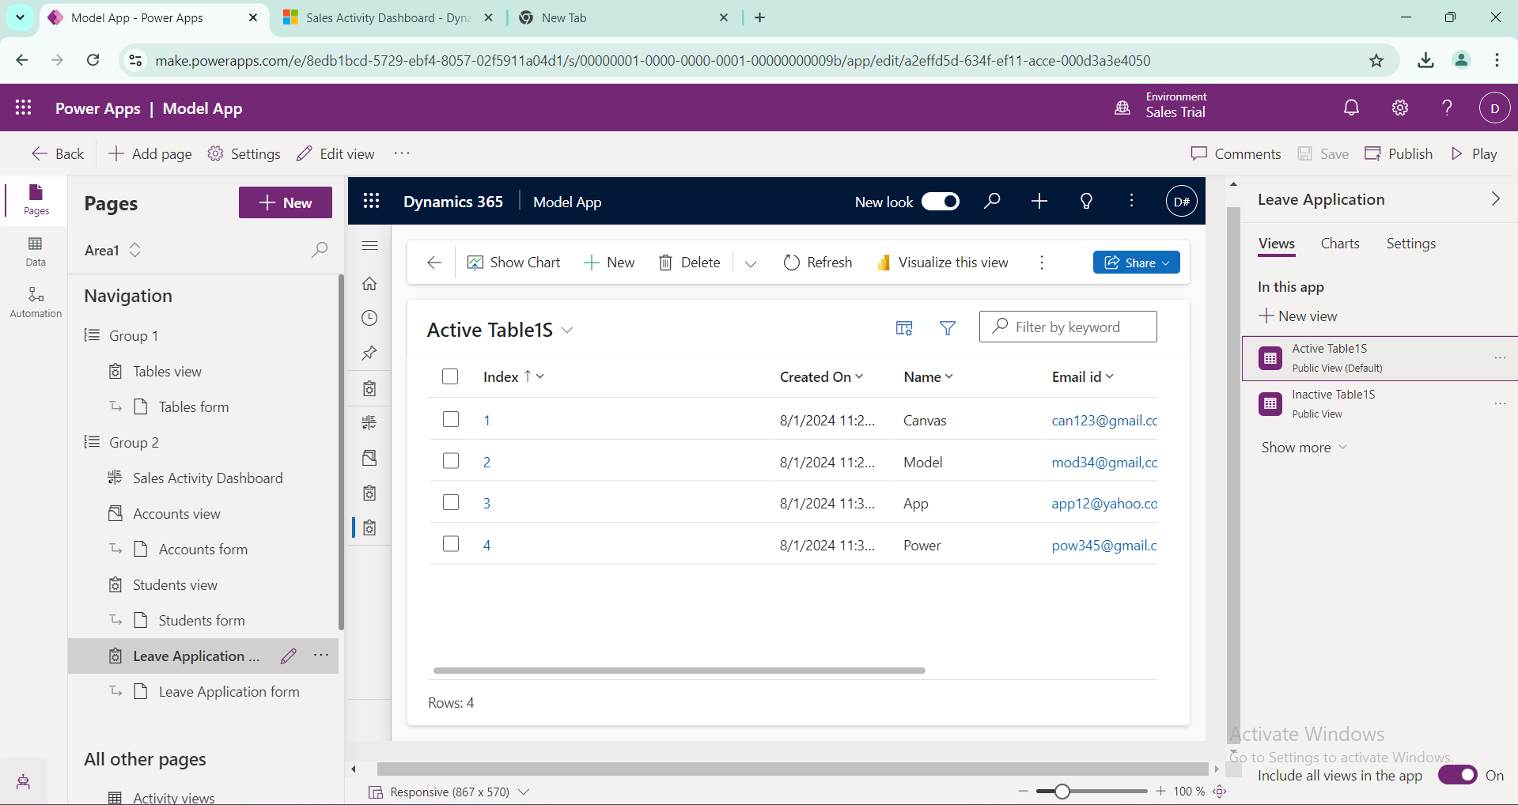
UI of Model driven app

Slide 90
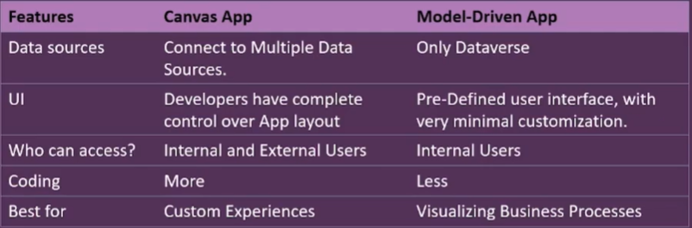
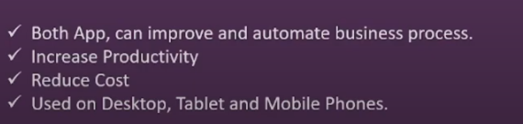
Canvas app Vs Model-driven apps
Similarities

Slide 91
Power Portal

Slide 92
Agenda
What is Power App Portal?
Components of Power App Portal.
How to create Power App Portal?
Examples of Power App Portal

Slide 93
Power portal
Power Portals, now referred to as Power Pages, are a feature within the Power Apps platform that allows you to create and manage external-facing websites or portals.
These portals enable users outside of your organization—such as customers, partners, or suppliers—to interact with your data and business processes in a secure and user-friendly way.

Slide 94
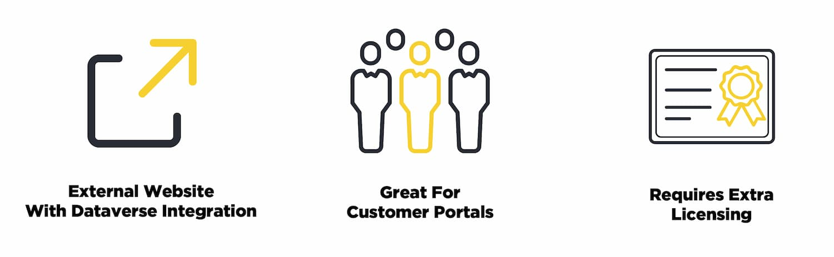
Power Apps Portal
Portals are quite a bit different than the previous two types of apps for a few reasons.
Allow internal and external access to view and update data within dataverse.
Meant for External Access
The Data is All Dataverse Data
Access to Data is Simplified By Using a Portal/Dataverse
Licensing is Much Different

Slide 95
Components of Power App Portal
Web Pages and Templates for content layout and structure.
Forms and Lists for data interaction.
Navigation Menus for user-friendly navigation.
Web Resources for custom HTML, JavaScript, and CSS.
Authentication and Security for managing user access.
Content Snippets for reusable content elements.
Business Rules and Workflows for process automation.
Analytics and Monitoring for performance tracking.
Custom Code and Extensions for added functionality.

Slide 96
Creating and Managing Power Pages
Creating a Power Page:
Go to the Power Apps Maker portal.
Select Create and choose Portal or Power Pages.
Use the provided templates or start from scratch to design your portal.
Configuring Data and Forms:
Define the data entities you want to expose on the portal.
Create and configure forms for data entry and viewing.
Designing and Customizing:
Use the portal designer to customize the layout, content, and styling.
Apply themes, add images, and configure navigation.

Slide 97
Setting Up Security:
Define web roles and permissions.
Configure authentication providers and access control lists.
Publishing and Managing:
Preview the portal to ensure it looks and works as expected.
Publish the portal to make it available to users.
Manage ongoing content updates and user interactions.

Slide 98
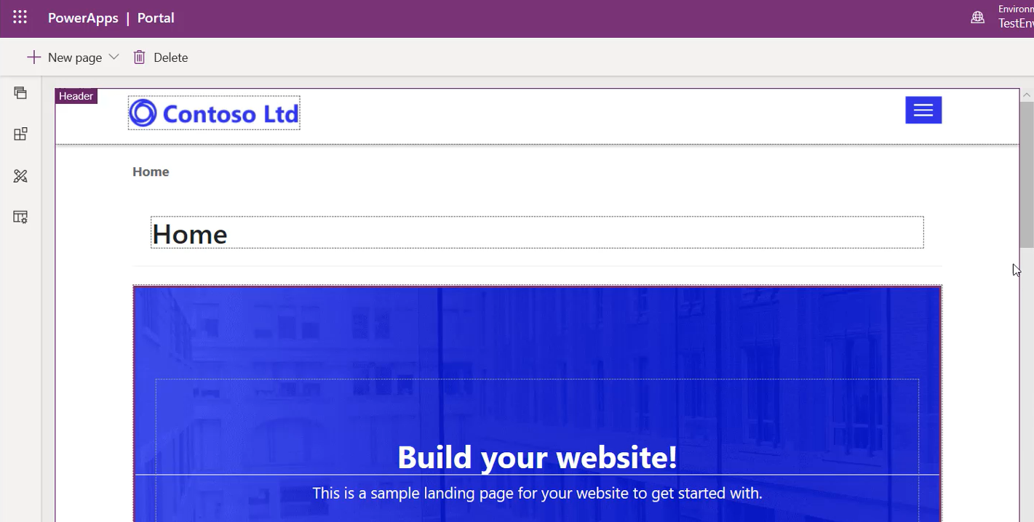
Example

Slide 99
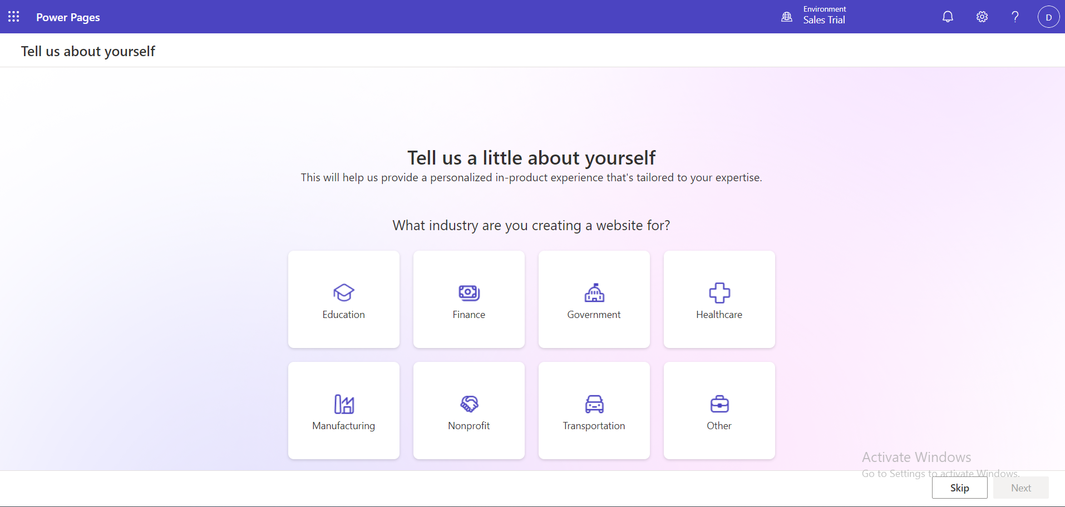
Start of Power pages.

Slide 100
THANK YOU

